Slide 1
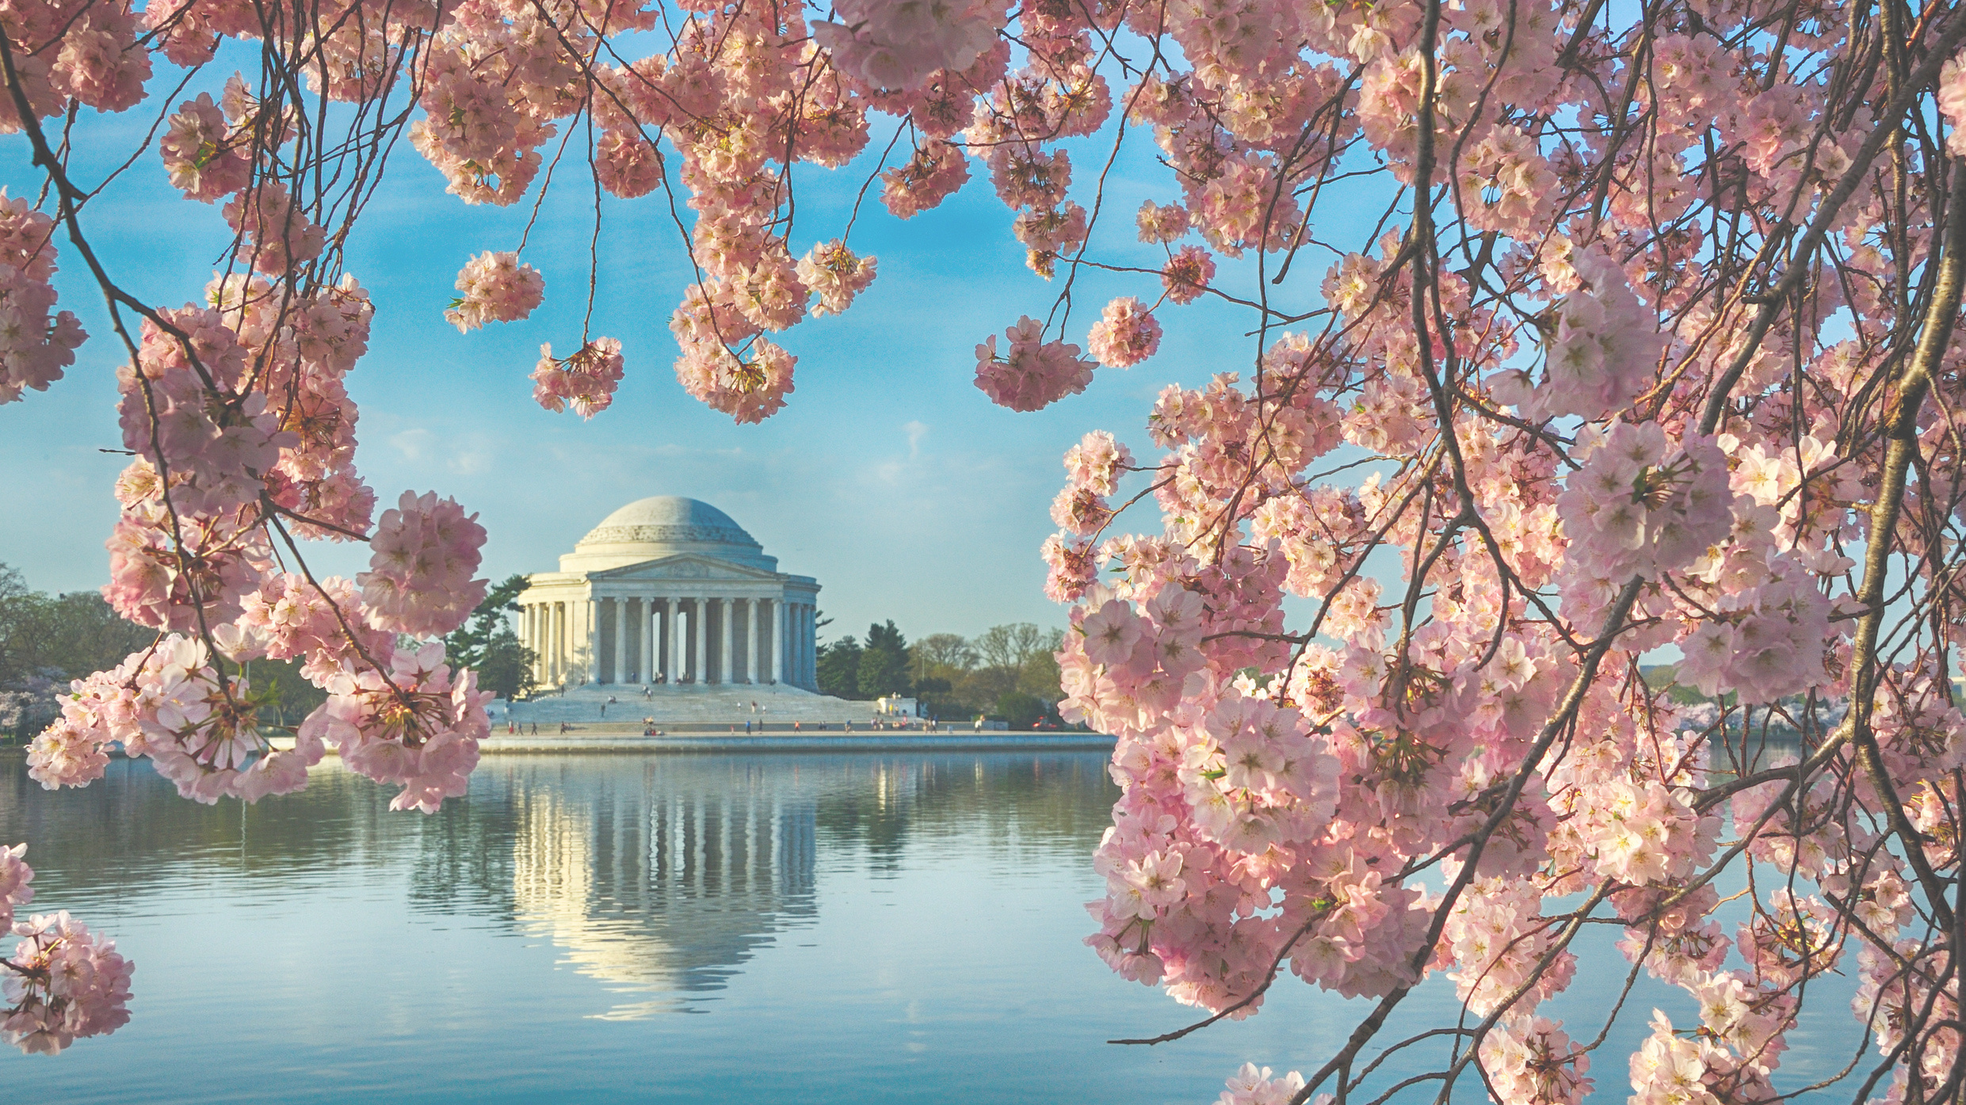
MARCH 15-16, 2024 • FRENCH EMBASSY, WASHINGTON DC
Name:
Session:
Presentation:
Your photo here

